Slide 1

GLORIYA ANTONY
gloriyaantony121@gmail.com
DGT
College Of Engineering, Kidangoor
Kerala
Data Analytics/[13/06/2023-24/07/2023]

Slide 2
Problem Statement
The problem is to analyze the dataset and identify the specific areas within the Superstore's operations that are underperforming in terms of profitability. This analysis will help uncover the factors contributing to low profitability, such as low sales, negative profit margins, high discount rates, or inefficient cost structures. By identifying these weak areas, the Superstore can develop targeted strategies to improve profitability and optimize its business operations.

Slide 3
INDEX
S.NO | PAGE NO | CONTENTS
1 | 4 | PROJECT OVERVIEW
2 | 6 | WHO ARE THE END-USERS?
3 | 8 | SOLUTION AND ITS VALUE PROPOSITION
4 | 10 | Modelling techniques, methodologies, and frameworks
5 | 12 | DATA SET
6 | 13 | HOW DID I CUSTOMIZE THE PROJECT?
7 | 14 | DATA VISUALISATION RESULT
8 | 15 | LINKS
9 | 16 | CONCLUSION

Slide 4
PROJECT OVERVIEW
The goal of this project is to analyze the Superstore dataset to gain insights into sales trends, customer behavior, and operational efficiency, ultimately leading to increased profitability and sustained business growth. The dataset contains information about various aspects of the store's operations, including sales, customer demographics, product categories, and geographical regions. By conducting a comprehensive analysis, we aim to identify opportunities for improvement and make data-driven recommendations to optimize store performance.

Slide 5
PROJECT OVERVIEW
OBJECTIVES
Identify sales trends, such as seasonal patterns and fluctuations, to optimize inventory management and sales forecasting.
Understand customer behavior by analyzing demographics, preferences, and purchase patterns to develop targeted marketing strategies and enhance customer satisfaction.
Improve operational efficiency by identifying bottlenecks, streamlining processes, and optimizing resource allocation for enhanced profitability.
Provide data-driven recommendations to optimize store performance, improve customer experience, and increase overall profitability based on the analysis findings.

Slide 6
WHO ARE THE END-USERS?
Target Audience or End Users:
•Store Managers: They require insights on sales performance, customer behavior, and
operational efficiency to make informed decisions and optimize store operations.
•Marketing Managers: They need information on customer demographics, preferences,
and buying patterns to develop targeted marketing campaigns and improve customer
engagement.
Characteristics and Needs:
•They seek comprehensive data analysis, visualizations, and actionable recommendations
to identify areas for improvement, enhance profitability, and streamline operations.

Slide 7
WHO ARE THE END-USERS?
Benefits from the Solution:
They will benefit from optimized inventory management, improved sales forecasting, and streamlined operations, leading to increased profitability and better customer satisfaction.
They will benefit from targeted marketing campaigns, enhanced customer engagement, and improved customer retention, resulting in increased sales and brand loyalty.

Slide 8
SOLUTION AND ITS VALUE PROPOSITION
The solution for the "Analysis of Superstore dataset project involves conducting a comprehensive analysis of the Superstore dataset to gain insights into sales trends, customer behavior, and operational efficiency. This analysis will be carried out using various statistical and data mining techniques, as well as advanced visualization tools.
Value Proposition: Our solution provides the following value propositions
I. Data-Driven Decision Making: By analyzing the Superstore dataset, we enable data-driven decision making for store managers and marketing managers. They can make informed decisions based on comprehensive analysis, leading to improved store performance, optimized operations, and targeted marketing strategies.

Slide 9
SOLUTION AND ITS VALUE PROPOSITION
II. Enhanced Profitability: Our analysis helps identify opportunities for increasing sales, improving inventory management, and reducing costs, ultimately leading to enhanced profitability for the Superstore. By optimizing pricing strategies, identifying high-demand products, and streamlining operations, the store can maximize its revenue and profitability.
III. Customer Insights and Personalized Marketing: By analyzing customer behavior, demographics, and preferences, our solution provides valuable insights to marketing managers. This enables them to develop personalized marketing campaigns, tailor promotions, and enhance customer engagement, resulting in increased customer satisfaction, retention, and ultimately, higher sales.
iv. Competitive Advantage: Leveraging the power of data analysis, our solution provides the Superstore with a competitive advantage in the market.

Slide 10
Modelling techniques, methodologies, and frameworks were applied:
Exploratory Data Analysis (EDA): EDA techniques were employed to gain initial insights into the dataset. This included data visualization through charts, graphs, and plots to understand the distribution of variables, identify outliers, and detect patterns or relationships between different variables.
Statistical Analysis: Utilized to uncover correlations, trends, and patterns within the Superstore dataset. These techniques helped in understanding the impact of various factors on sales, customer behavior, and operational efficiency.

Slide 11
Modelling techniques, methodologies, and frameworks were applied:
Customer Segmentation: applied o categorize customers based on their attributes and buying behavior. This allowed for the identification of distinct customer groups with specific needs and preferences, enabling targeted marketing strategies.
Data Visualization: Advanced data visualization techniques using tools like Python libraries (e.g., Matplotlib, Seaborn) were used to create visually appealing and informative charts, graphs, and dashboards. These visualizations facilitated the effective communication of analysis results and provided a clear representation of key findings. These modelling techniques, methodologies, and frameworks formed the foundation of the "Analysis of Superstore dataset" project for Data Analytics, ensuring a systematic and data-driven approach to extract valuable insights from the dataset.

Slide 12
DATA SET
DATA set URL:
https://github.com/ayirolg/Super-Store-Analysis/blob/main/SampleSuperstore.csv
About the dataset: the dataset provides information about the sales and profit from a supermarket.
Dataset details : the dataset contains the following dataset
SIZE | 543 KB
NO. OF COLUMNS | 21
NO. OF ROWS | 9994
ORIGINAL FILE FORMAT | CSV

Slide 13
HOW DID I CUSTOMIZE THE PROJECT
Data visualization is a regular part of projects involving data analysis, but my method stands out by making use of the potent tools Matplotlib and Seaborn. These libraries include a wide range of customization possibilities, enabling the development of aesthetically pleasing and illuminating charts, graphs, and plots. My approach improves understanding of complicated patterns and relationships within the Superstore dataset by presenting data in a visually appealing manner and utilizing the capabilities of Matplotlib and Seaborn.
Interactive Dashboards: My solution includes interactive dashboards to deliver an amazing user experience. These dashboards give users the ability to interactively explore and interact with the data that has been evaluated, allowing them to dig down into particulars, use filters, and visualize various dimensions. The dashboards' interactive features increase engagement.

Slide 14
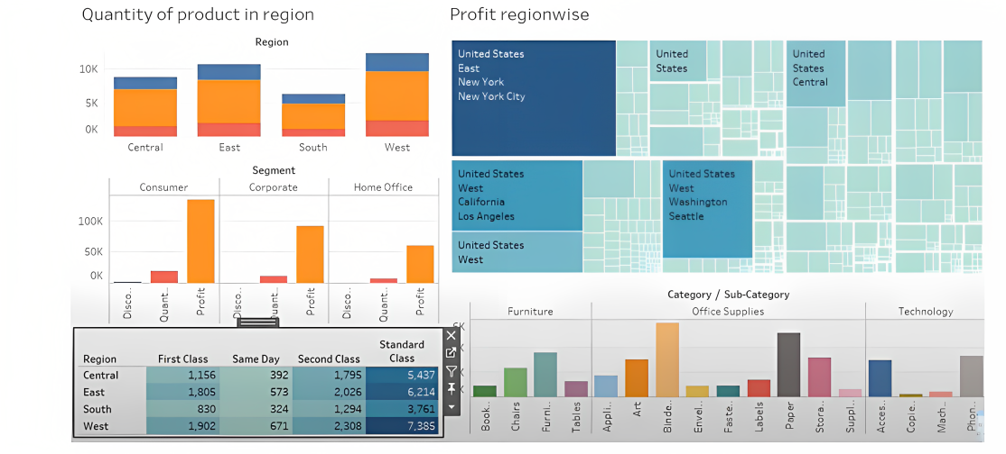
DATA VISUALISATION RESULT

Slide 15
LINKS
GITHUB LINK : https://github.com/ayirolg/Super-Store-Analysis
GOOGLE COLLAB : https://colab.research.google.com/drive/1L0M_ypVdZ9zv-epdpTVgcyF7jIKUagMA?usp=sharing
Research Papers
SALES ANALYSIS ON SUPERSTORE DATASET https://www.irjmets.com/uploadedfiles/paper//issue_4_april_2023/36572/final/fin_irjmets1682186035. pdf
Chakraborty, M. (2020). Sales Analysis of Superstore using Power BI. Kaggle. https://www.kaggle.com/moumoyesh/sales-analysis-of-superstore-using-power-bi
Microsoft. (n.d.). Analyse and visualize Superstore data in Power Bl. https://powerbi.microsoft.com/en- us/tutorials/analyse-and-visualize-superstore-data/
Pranav, B. (2021). Sales Analysis of Superstore Data using Power BI. Analytics Vidhya. https://www.analyticsvidhya.com/blog/2021/04/sales-analysis-of-superstore-data-using-power-bi/
Other
Super Store Sales Analysis
https://medium.com/analytics-vidhya/exploratory-data-analysis-super-store-cb91c37bcb06

Slide 16
CONCLUSION
The analysis of the Superstore dataset has provided valuable insights into sales trends, customer behavior, and operational efficiency. Through exploratory data analysis and advanced modeling techniques, we have identified several significant findings:
•Sales Trends: The analysis revealed seasonal patterns, with peak sales occurring during specific months. Additionally, certain product categories exhibited higher demand and profitability than others, indicating opportunities for strategic focus and optimization

Slide 17
CONCLUSION
•Customer Segmentation
•Predictive Insights: These insights enable proactive decision-making and assist in effective resource planning and inventory management.
•Enhanced Profitability
•Improved Decision Making
•Customer Satisfaction and Retention

Slide 18
CONCLUSION
Moving forward, it is recommended that the Superstore continues to monitor sales performance, customer behavior, and operational metrics. This will allow for ongoing adjustments and improvements based on changing market dynamics and evolving customer preferences.
Overall, the "Analysis of Superstore dataset" project demonstrates the power of data analytics in uncovering insights that drive strategic decision-making, operational efficiency, and ultimately, the success of the Superstore in a competitive retail market

Slide 19
Thank you
GLORIYA ANTONY
gloriyaantony121@gmail.com

